Slide 1
Da Bomb: Beyond Insanity - Automating Red Teaming using Atomics 🚀
Steve Myrick
Manager, Product Security

Slide 2

Whoami (@stevemyrick)
Manager of Adversarial Engineering, AppSec, & DevSecOps @ Avalara
Offensive security professional for ~8 years
Organizer for EverSec CTF
Lives in North Carolina
Had two flights cancelled trying to get here

Slide 3

Summary
Problem Statement
01
What is MITRE ATT&CK?
02
Why track metrics?
03
What is Atomic Red Team?
04
How to deploy at scale
05
Looking forward
06

Slide 4
Problem Statements (in the form of user stories)
As an offensive security engineer, I want to be able to emulate realistic attack scenarios in order to highlight vulnerabilities to my client
As a defensive security engineer, I want to be able to track detections and alerting in order to understand my capabilities to identify real attacks
As a security executive, I want to be able to able to visualize and track improvements to my security program in order to measure progress
… and everyone wants to do all of this at scale.

Slide 5


”Do more with less”
- Literally everyone
Notes:
Let’s say “multiply your impact”

Slide 6
10,000 Foot View
“We need to be able to clearly communicate actual impact of realistic adversarial emulation automatically across an entire enterprise to improve our security posture and monitor progress”
Notes:
If you’re going to pitch to your execs

Slide 7

MITRE ATT&CK
Knowledge base of adversary tactics and techniques
14 Tactics, 234 techniques, >400 sub-techniques*
Used by cybersecurity professionals to understand and replicate adversary behavior for better defense strategies.
Helps red/blue teams speak the same language
Maps to MITRE D3FEND, but that’s another talk
*updated bi-annually

Slide 8
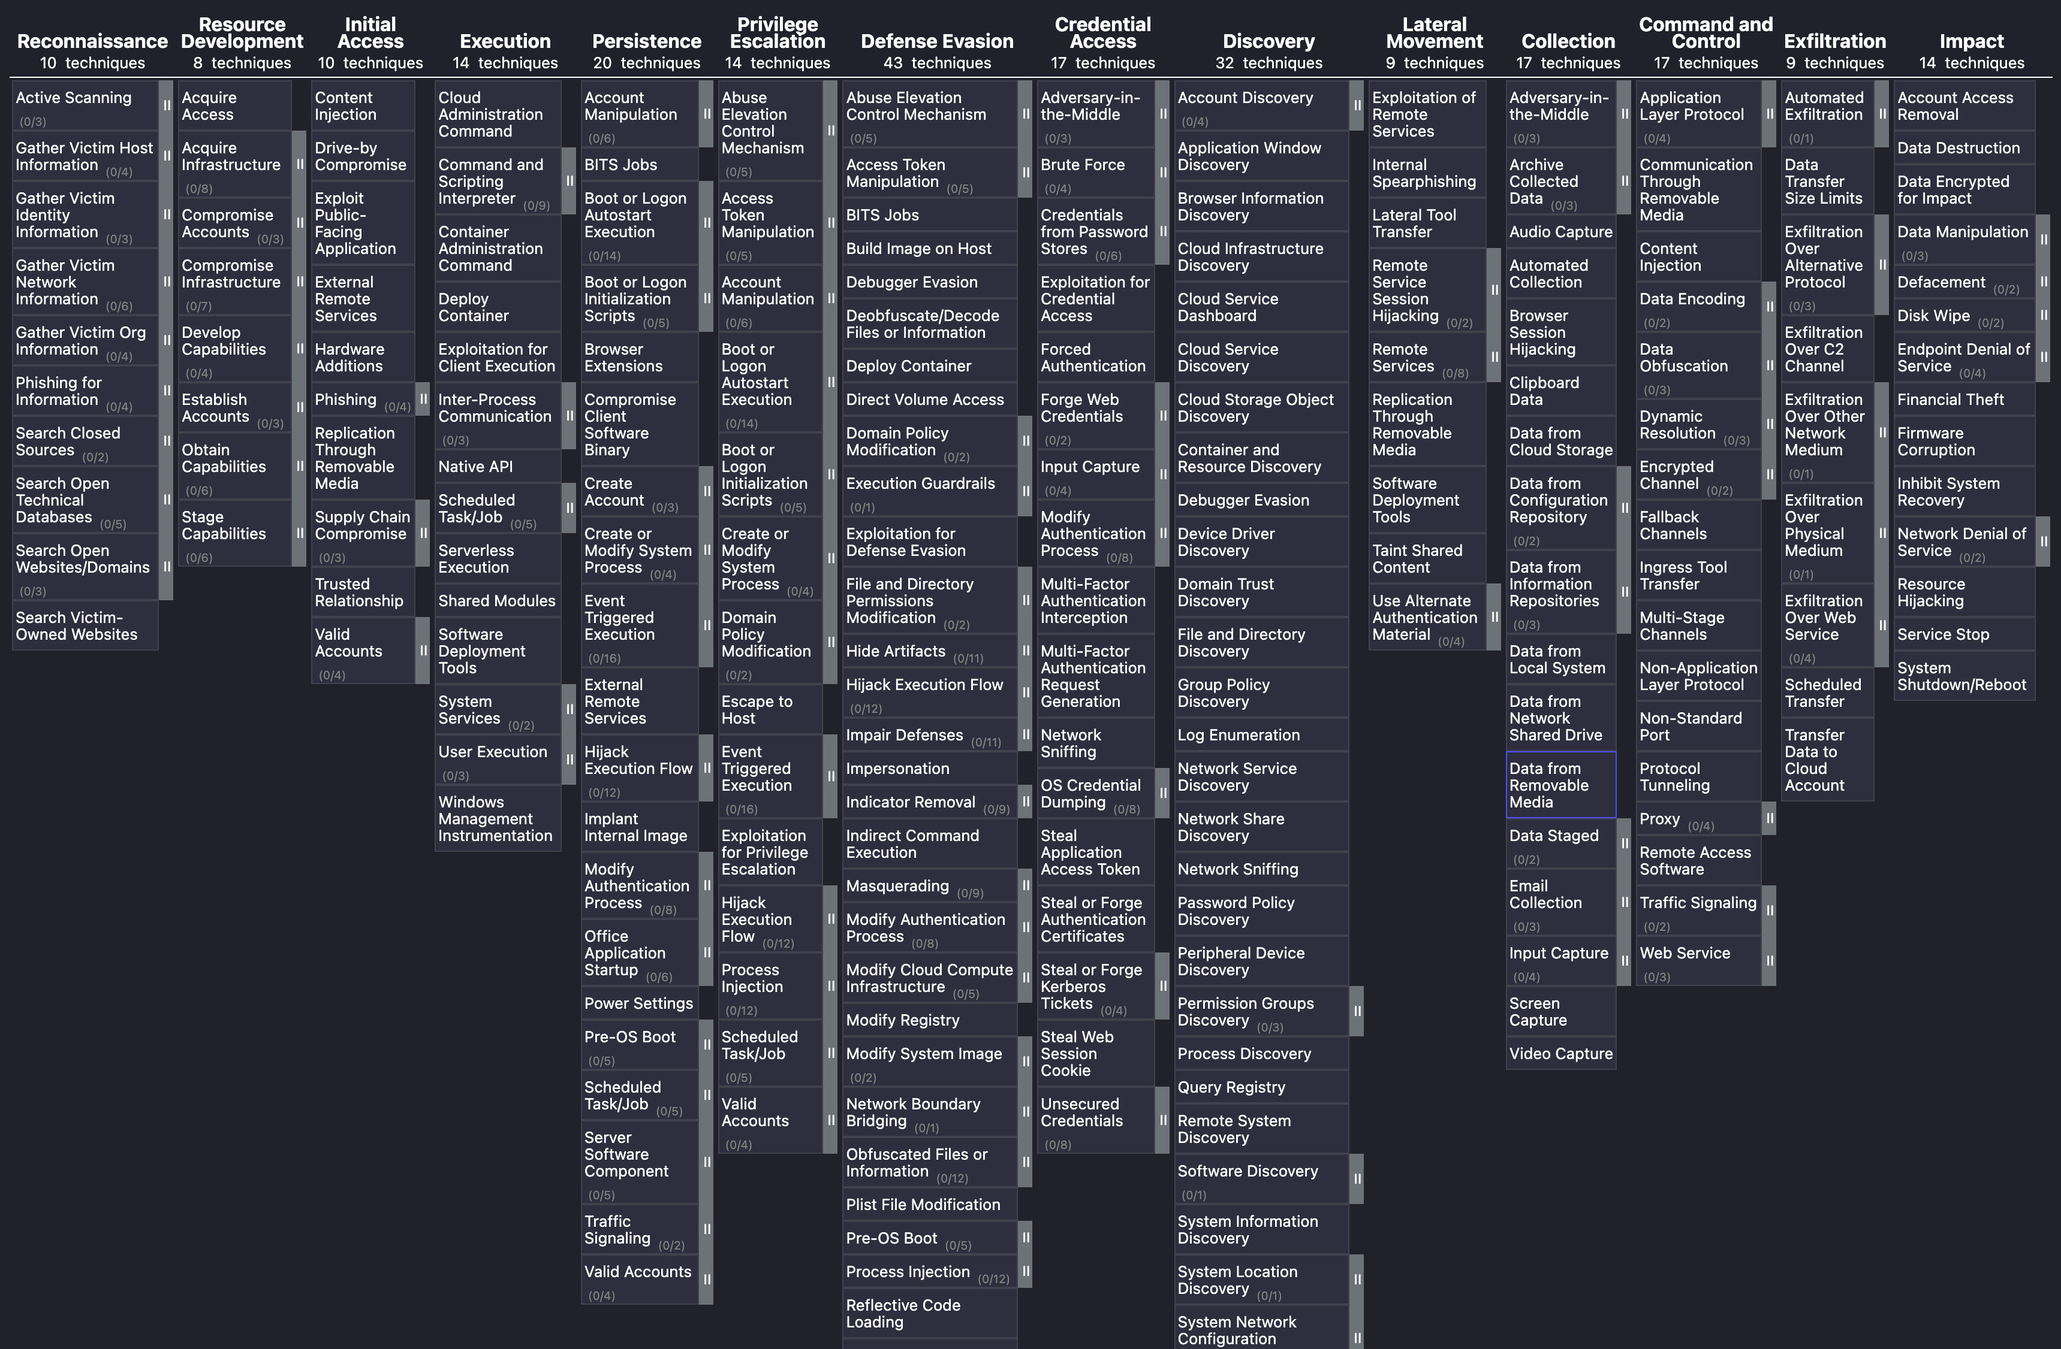

Slide 9
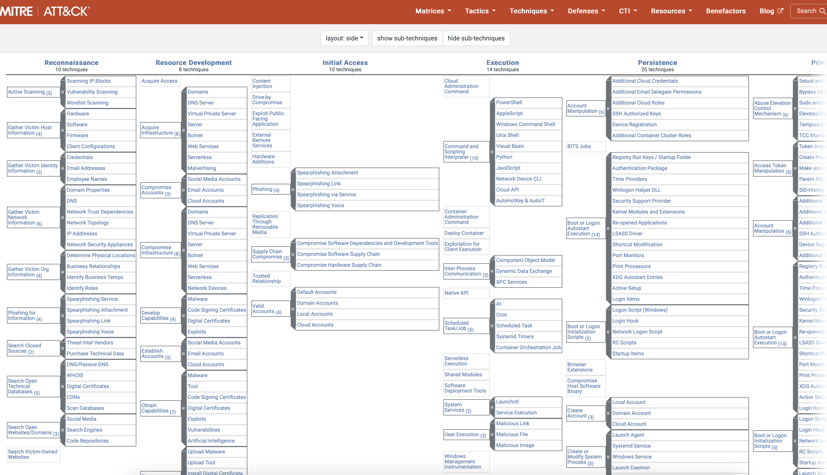
= (potential) years of work

Slide 10
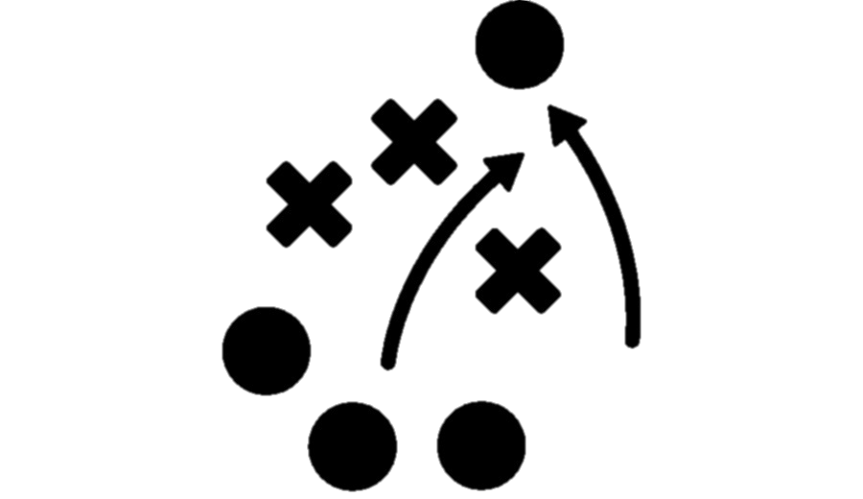
What’s a “tactic”?
“Why” or the reason an adversary is performing an action
Examples:
TA0043 Reconnaissance - The adversary is trying to gather information they can use to plan future operations.
TA0008 Lateral Movement - The adversary is trying to move through your environment.
TA0010 Exfiltration - The adversary is trying to steal data
Facilitates strategic planning and defense prioritization by understanding attacker goals.
Notes:
When discussing Atomic Red Team and MITRE ATT&CK, one crucial aspect to consider is understanding the "why" behind an adversary's actions. In other words, we need to comprehend the reason an adversary is performing a particular action.
Let’s go through some examples to illustrate this:
TA0043 Reconnaissance: Here, the adversary's goal is to gather information that they can use to plan future operations. This could involve activities such as scanning for vulnerabilities or mapping out the network.
TA0008 Lateral Movement: This involves the adversary trying to move through your environment. They may use techniques to gain access to other systems or accounts within the network to escalate their privileges and expand their control.
TA0010 Exfiltration: At this stage, the adversary is attempting to steal data. They might employ various methods to extract sensitive information from your environment without detection.
Understanding these motivations is crucial because it helps us in two significant ways:
Facilitating Strategic Planning: By knowing why an adversary is performing a certain action, we can better anticipate their next moves and plan our defenses accordingly.
Defense Prioritization: Understanding attacker goals allows us to prioritize our security measures. We can focus our resources on the most critical areas that are likely to be targeted, enhancing our overall security posture.
In summary, grasping the "why" behind an adversary's actions is a key component of effective cybersecurity strategy. It not only aids in planning but also ensures that our defenses are robust and well-prioritized, thereby improving our resilience against attacks.

Slide 11

What’s a “technique”?
“How” adversaries achieve tactical goals by performing an action
Example:
T1595 Active Scanning - Adversaries often perform active reconnaissance scans, probing victim infrastructure with network traffic to gather information for targeting, unlike passive reconnaissance that avoids direct interaction.

Slide 12

What’s a “sub-technique”?
A more specific or lower-level description of adversarial behavior
Example (under previously mentioned Active Scanning Tactic T1595):
T1595.001 – Scanning IP Blocks
Adversaries may scan victim IP blocks, which are ranges of sequential public addresses allocated to organizations, to collect targeting information.
T1595.002 – Vulnerability Scanning
Adversaries may scan victims for vulnerabilities, checking configurations (like software versions) to identify exploitable targets.
T1595.003 – Wordlist Scanning
Adversaries may use brute-forcing and crawling to probe infrastructure, focusing on identifying content rather than credentials. These scans often use wordlists with common or custom terms, informed by prior reconnaissance like victim organization data.
Notes:
This is what takes time. Each of these can be done 1000 ways and all take time to develop.

Slide 13
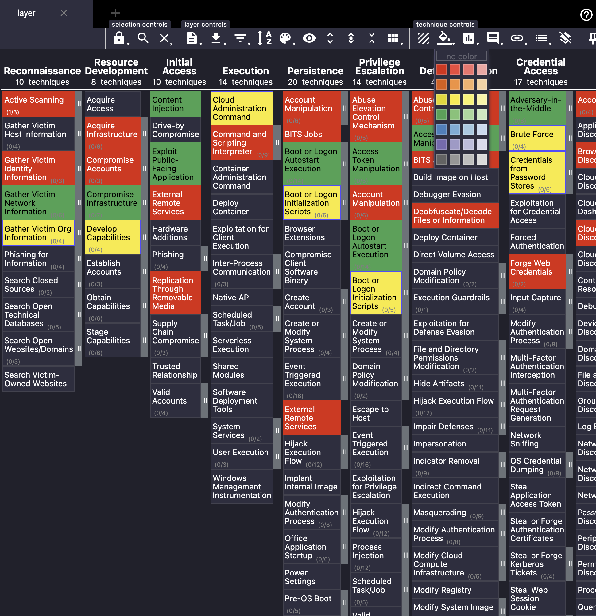
Basic tool to get started
MITRE ATT&CK Navigator
https://mitre-attack.github.io/attack-navigator/
Pros
Web-based
OSS
Exportable
Cons
Not easily extensible
Missing detailed reporting features

Slide 14
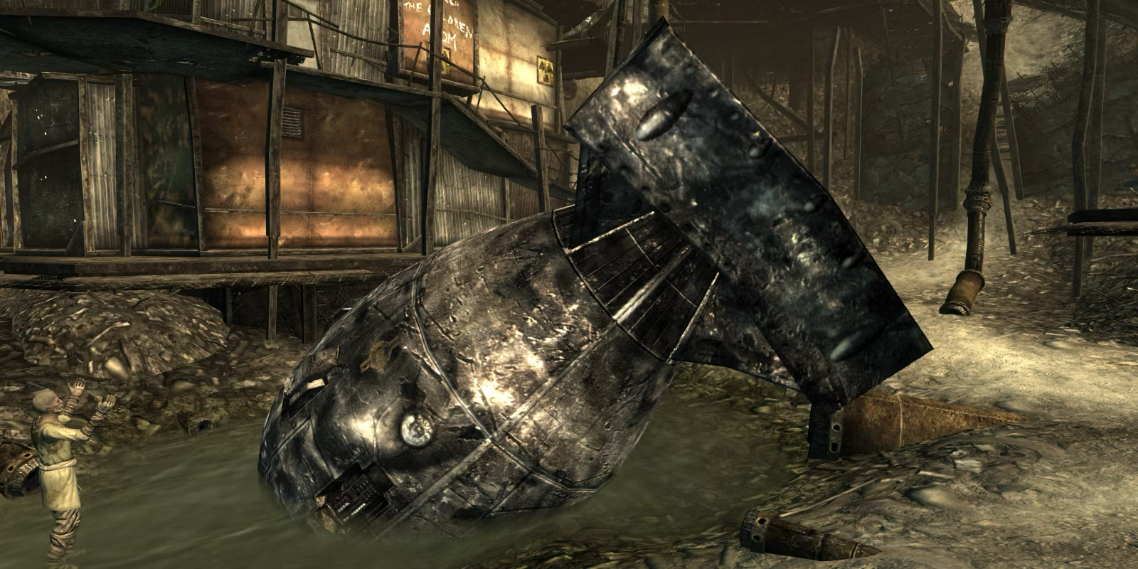

What are atomics?
Atomics are simple, actionable tests designed to emulate specific tactics or techniques used by adversaries.
Provide a practical method to simulate attacks and assess the effectiveness of security measures.
Each atomic test is small and self-contained, focusing on a single technique.
Easily executable with minimal setup, making them ideal for rapid testing.
👍

Slide 15
Example Atomic: T1110 - Brute Force
Objective: Simulate an adversary attempting brute force attacks on active directory accounts to assess the resilience of account lockout policies.
Atomic Test #1 - Brute Force Credentials of single Active Directory domain users via SMB
Atomic Test #2 - Brute Force Credentials of single Active Directory domain user via LDAP against domain controller (NTLM or Kerberos)
Atomic Test #3 - Brute Force Credentials of single Azure AD user
Atomic Test #4 - Password Brute User using Kerbrute Tool
Atomic Test #5 - SUDO Brute Force - Debian
Atomic Test #6 - SUDO Brute Force - Redhat
Atomic Test #7 - SUDO Brute Force - FreeBSD
Atomic Test #8 - ESXi - Brute Force Until Account Lockout
Notes:
https://www.youtube.com/watch?v=iNl_rltYmoo
https://github.com/redcanaryco/atomic-red-team/blob/master/atomics/T1110.001/T1110.001.md

Slide 16
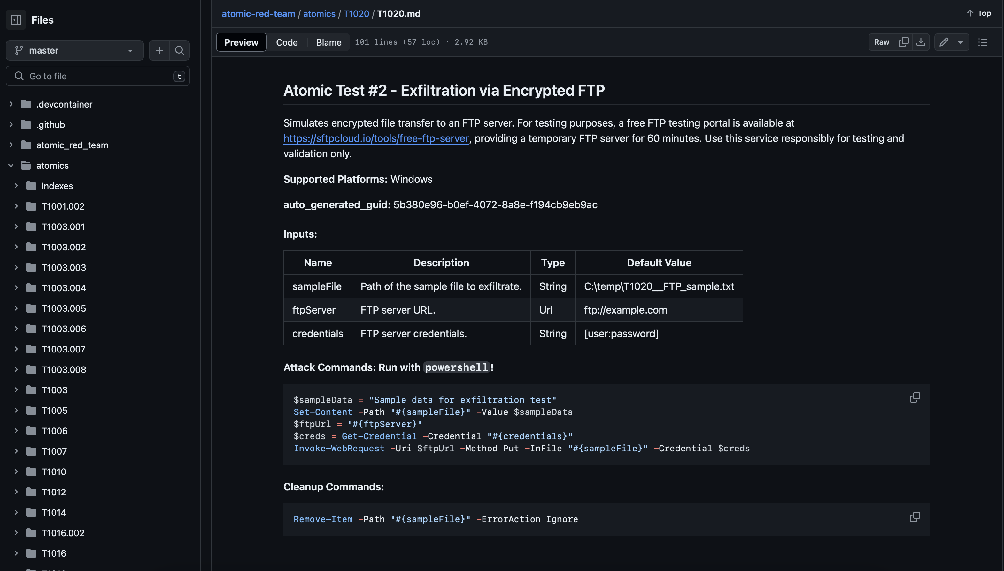

Slide 17
(Demo here)
(the demo went here, but if you downloaded this from Github, it wouldn’t let me upload it because it was too big. Go check out the recording instead)

Slide 18
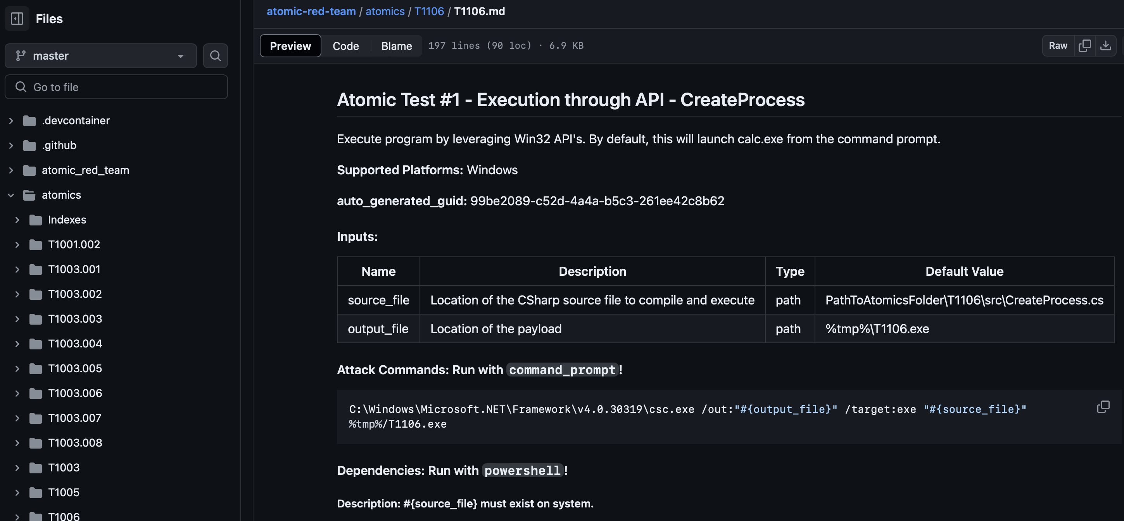
What just happened?

Slide 19

Measure Your Effectiveness
Example Metrics:
Detection Rate: Percentage of attacks that are detected by your security systems.
Response Time: Time taken from detection to response, showcasing the agility of your incident response.
Framework Coverage: Extent of techniques and tactics tested against the MITRE ATT&CK framework.
Attack Outcome: Effectiveness of the defensive response measured by the ability to prevent or alert on simulated attacks.

Slide 20
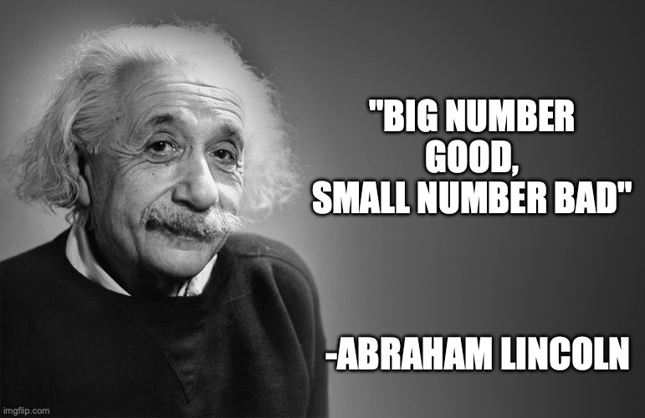
Key points to tracking good metrics
Goal-aligned
Specific
Clear
Measurable
Adaptable

Slide 21

Alerting vs Blocking
All blocking should generate alerts, but not all alerts lead to blocking
Will depend on tactic – not all tactics warrant blocking
Risk-informed blocking
Notes:
Risk-informed blocking (user behavior, asset criticality, etc)

Slide 22
Alerting vs Blocking
Example:
Red - No alerts, logs, or visibility
Orange – Inconsistent logs, no blocking
Yellow – Detailed logs, but no blocking
Green – Detailed logs, full automated blocking

Slide 23

Engagements vs Wholistic Overview aka Assessments vs Campaigns
Multi-level heatmap
Tell a story of continuous improvement
Explain gaps in coverage
Allows for smaller, iterative testing

Slide 24

What is VECTR?
Verification, Extraction, and Close-Loop Tracking Response
Helps security teams track and improve their detection and response capabilities through attack simulations and purple team exercises.
Glorified MITRE heat map?

Slide 25
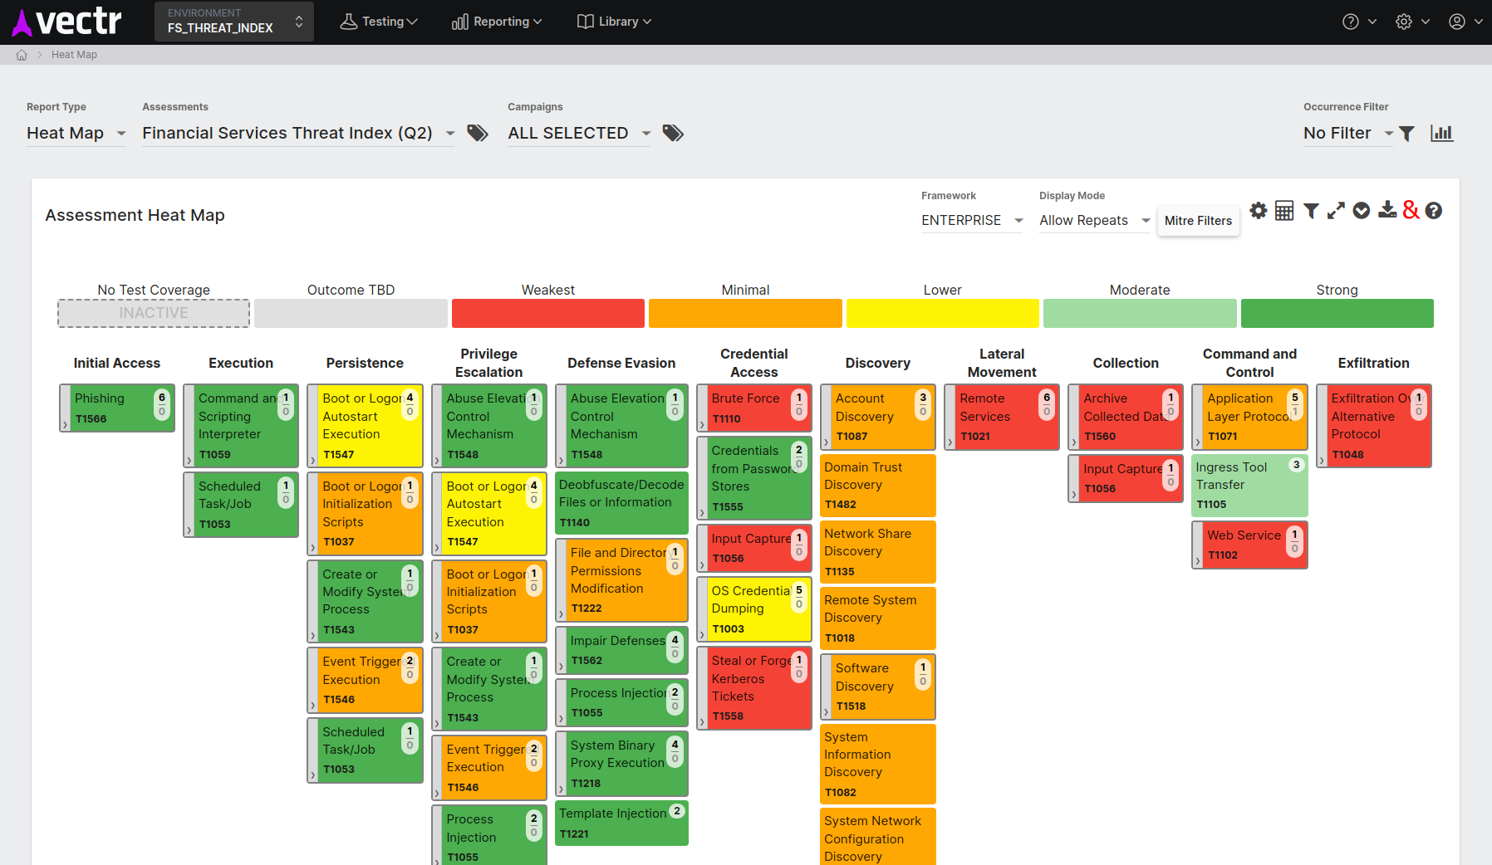

Slide 26
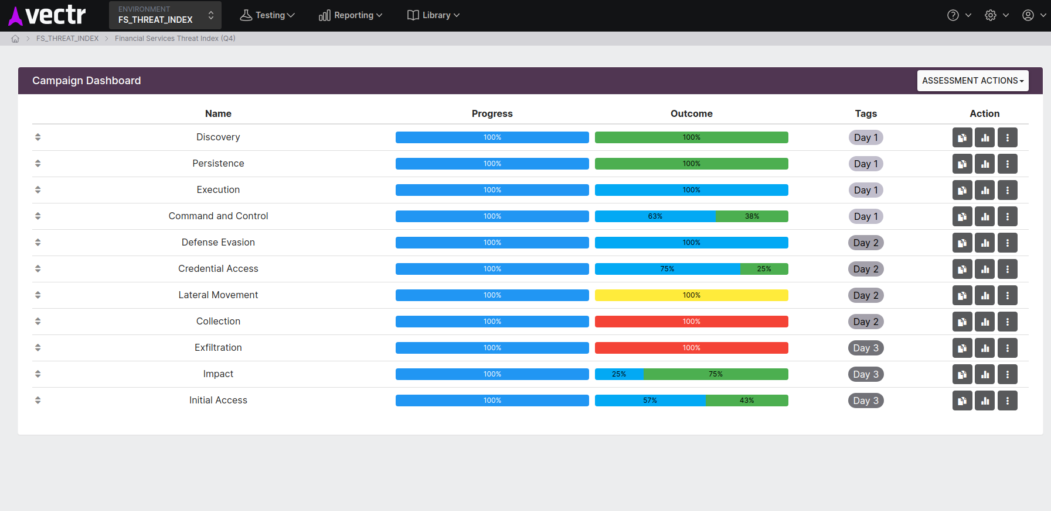
Notes:
Track a campaign and see how well you did

Slide 27
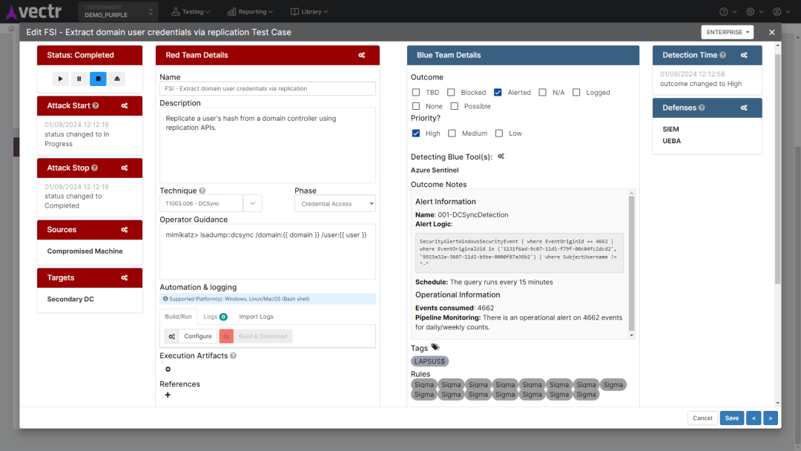
Notes:
Talk about purple team

Slide 28
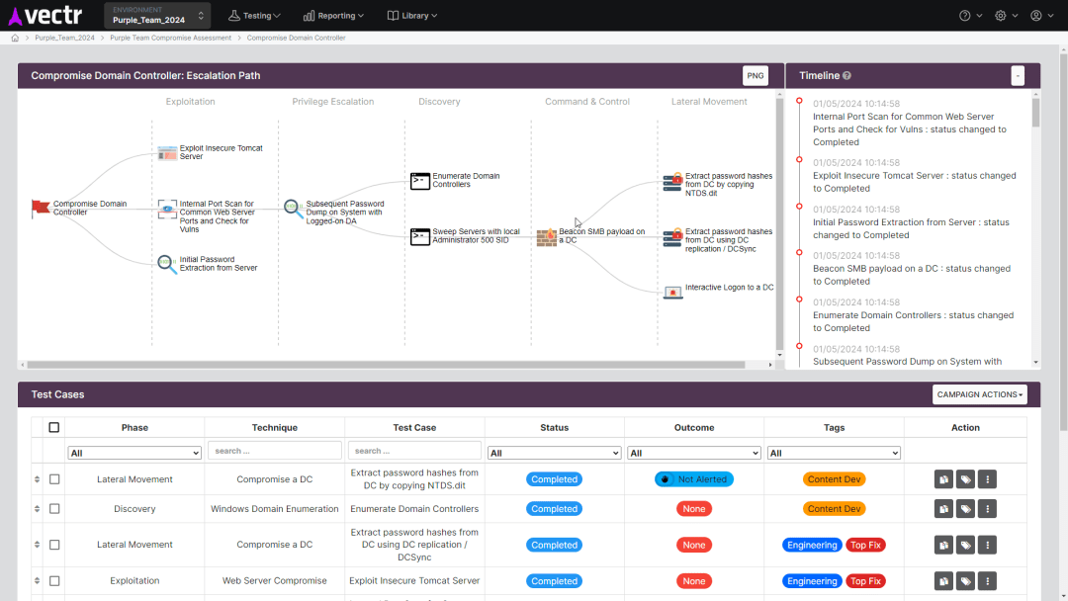
Notes:
Drill down in to attack kill chain

Slide 29
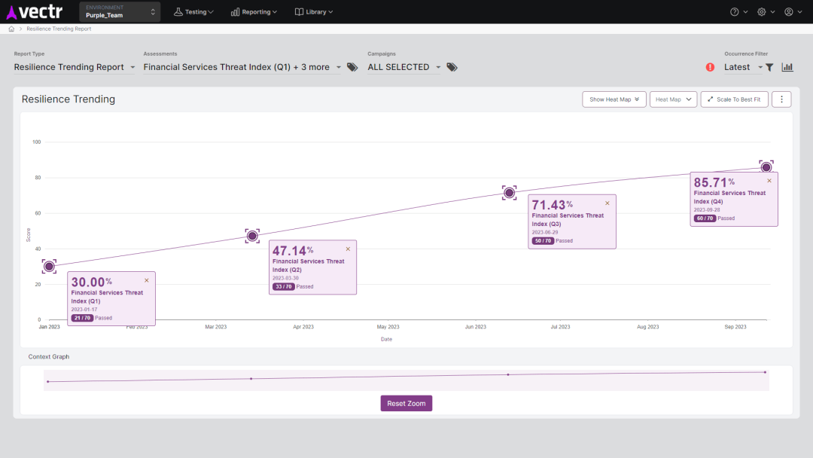
Notes:
Track against indexes from various industries

Slide 30
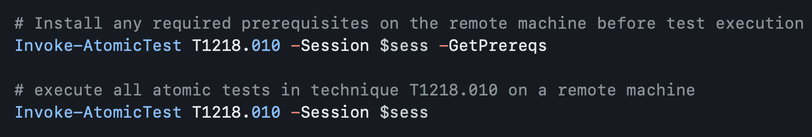
Automating Deployment of Atomics (one-off)
Remote must have PowerShell Remoting enabled
Technically can be done on Linux, MacOS, and Windows
First establish a PS session ($sess) to the Remote machine
Then:
Notes:
https://github.com/redcanaryco/invoke-atomicredteam/wiki/Execute-Atomic-Tests-(Remote)

Slide 31



Automating Deployment of Atomics (systemically)
Windows
Linux
Other
GPO
SCCM
PowerShell Remoting
SSH
SCP
Rsync
Salt
Tanium
Ansible
Chef
Puppet
Notes:
There are several options to push and execute PowerShell or Bash scripts to multiple computers on a managed network:
Group Policy: If your environment is Windows-centric and Active Directory is in use, Group Policy can be a powerful tool. You can create a Group Policy Object (GPO) that includes a startup or login script, which will be executed by every computer or user within the defined scope.
Configuration Management Tools: Tools like Puppet, Chef, or Ansible are designed for managing and automating configurations across large numbers of servers. They offer capabilities to execute scripts remotely and ensure consistency across the network.
PowerShell Remoting: PowerShell supports remote execution. You can use commands like Invoke-Command to run scripts on remote machines. However, this requires that PowerShell remoting is enabled on the target machines and proper authentication/authorization is configured.
SSH: For Unix-based systems, SSH is a standard way to remotely execute commands. You can use tools like ssh, scp, or rsync to push scripts to multiple machines and execute them.
Third-party Software: There are various third-party software solutions available for managing and deploying scripts across networks. These tools often provide centralized management interfaces and additional features like scheduling, logging, and reporting.
Scheduled Tasks: You can schedule scripts to run at specific times using the built-in Task Scheduler in Windows or cron jobs in Unix-based systems.
Deployment Platforms: Platforms like Microsoft Endpoint Configuration Manager (formerly SCCM) or other deployment solutions allow you to push scripts and software packages to multiple computers and manage their execution centrally.
Custom Solutions: Depending on your specific requirements and environment, you may develop custom solutions using programming languages like Python or C# to remotely execute scripts on multiple machines.
Each option has its pros and cons, so the choice depends on factors such as your organization's existing infrastructure, security requirements, and desired level of automation and control.

Slide 32

Monitoring for regression Atomic Runner
Schedule out atomics
Report on failures
Keep a live view on your network
Saves you from writing your own script

Slide 33

Adversary Emulation
Executing atomic tests in sequence
Emulate your favorite adversary group!
(maybe you’re your favorite adversary group)
Notes:
https://github.com/redcanaryco/invoke-atomicredteam/wiki/Adversary-Emulation
Fancy bear, cozy bear, Lazarus group, double dragon

Slide 34
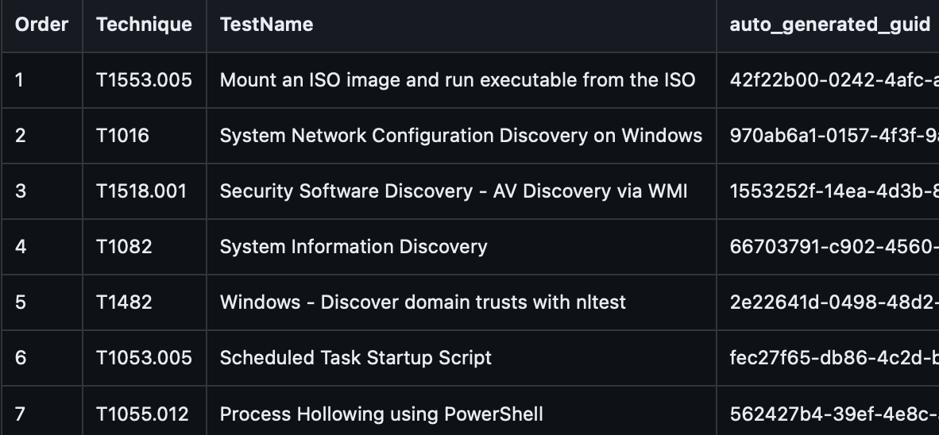
Adversary Emulation
Example: IcedID
Modular banking trojan that targets financial information and is used as a malware dropper
Notes:
https://github.com/redcanaryco/invoke-atomicredteam/wiki/Adversary-Emulation
Fancy bear, cozy bear, Lazarus group, double dragon

Slide 35

So, no need for a Red Team?
Allows red teamers to be red teamers, not checkbox compliance robots
Creativity and innovation not included
Red trains blue, and vice-versa
Doesn’t account for true evasion
Provides no strategic recommendations
People translate business context, not graphs

Slide 36
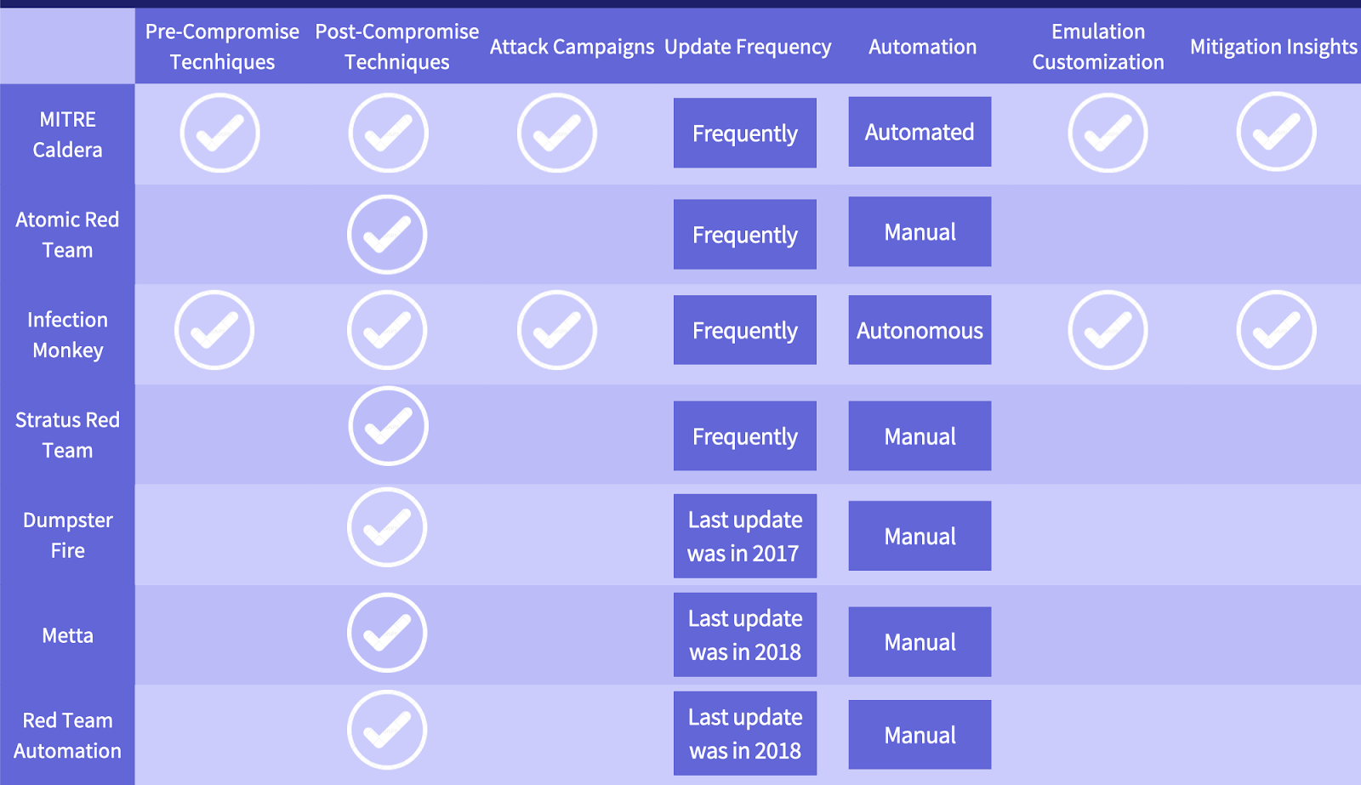
Current Alternatives
Caldera by MITRE
Pros: Highly configurable
Cons: Complicated
Infection Money by Guardicore
Pros: Lateral movement emulation
Cons: Loud
Stratus Red Team by Datadog
Pros: Cloud-focused
Cons: Supported environments
Notes:
https://www.picussecurity.com/resource/blog/data-driven-comparison-between-open-source-adversary-emulation-tools

Slide 37
Looking Forward
Increase in complexity of attacks
Market conditions favor efficiency
Growing need for compliance “proof”
More distributed, ephemeral networks require automation

Slide 38

Honorable mentions
Bug Bounty Programs
Pentesting-as-a-service
Continuous Automated Red Teaming (CART)
Yes, AI
Notes:
BBP – pay per finding
PTaaS – pay per feature
CART – a bit more dynamic

Slide 39


